Slide 1

30 Million E-commerce Data Analysis Report
JR Academy
Data Analyst - Helena Li

Slide 2
Report Content
30 Million Sales Data Exploration
Data Clustering

Slide 3
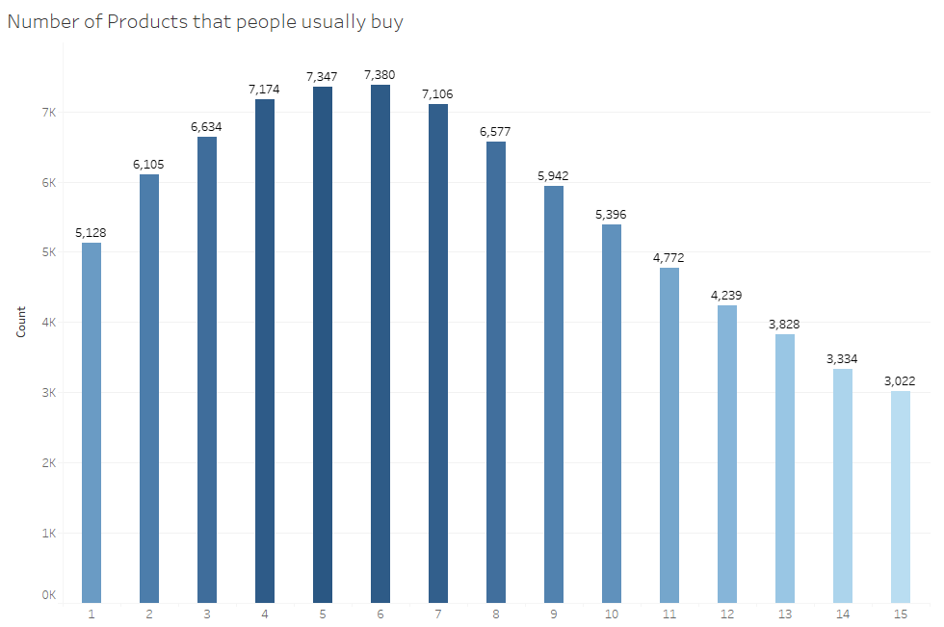
Data Exploration -Number of products that people usually buy

Slide 4
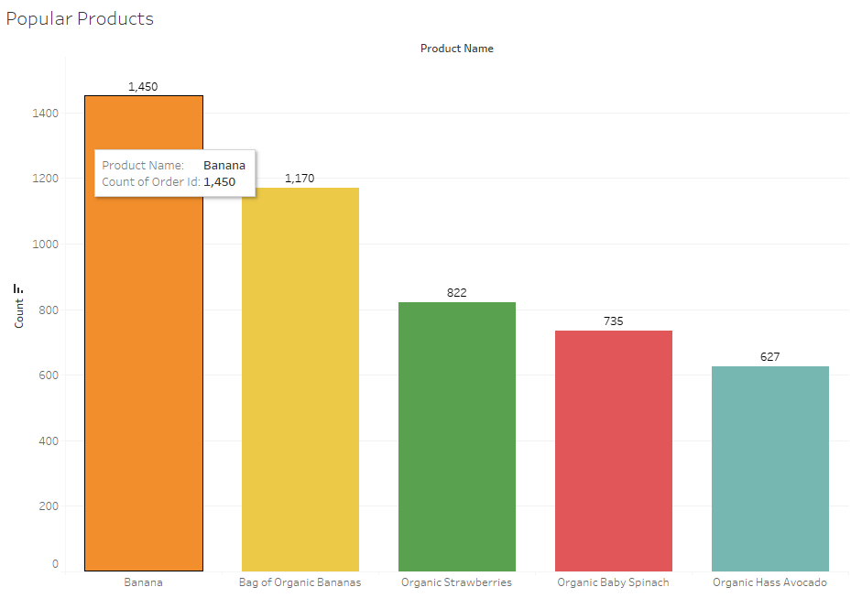
-Popular Products

Slide 5
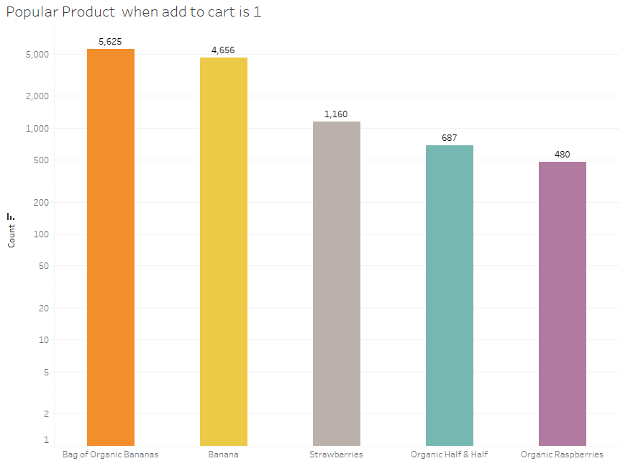
-Popular Product when add to cart is 1

Slide 6
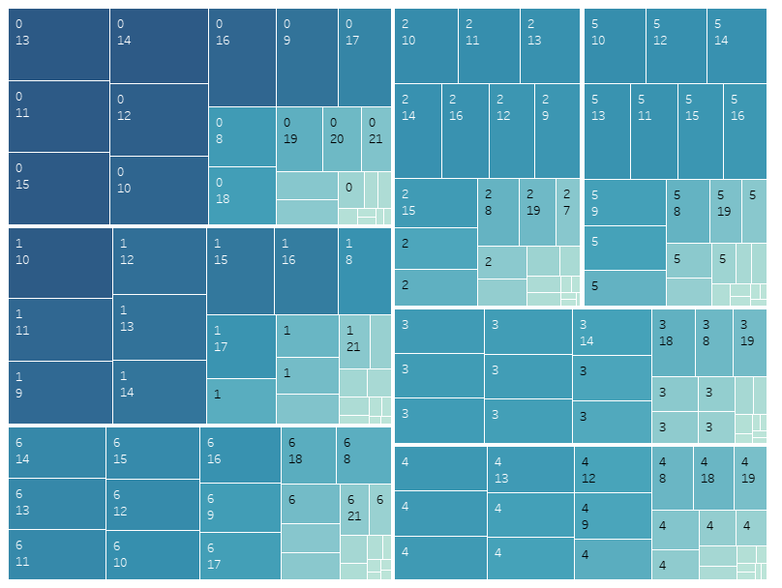
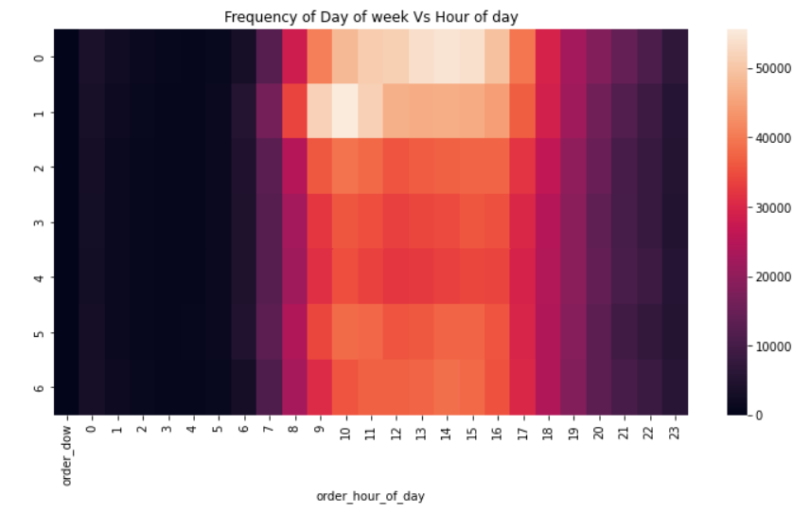
-Heatmap for order dow and hour of time

Slide 7
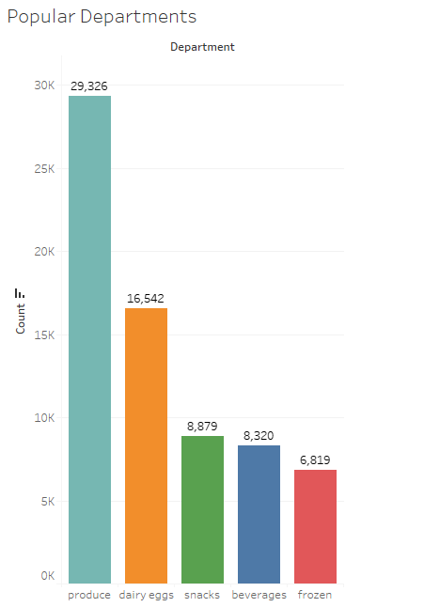
-Popular Departments

Slide 8
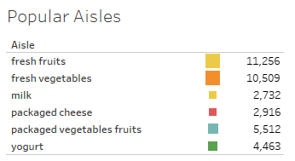
-Popular Aisles

Slide 9
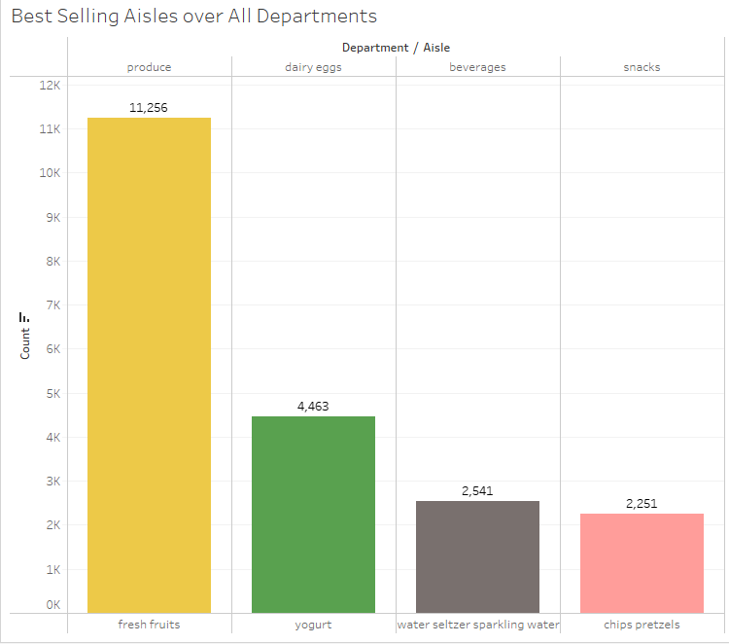
-Best Selling Aisles over All Departments

Slide 10
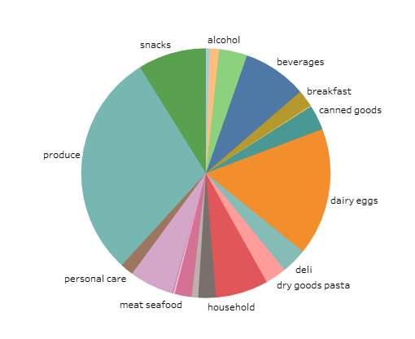
-Department Distribution

Slide 11
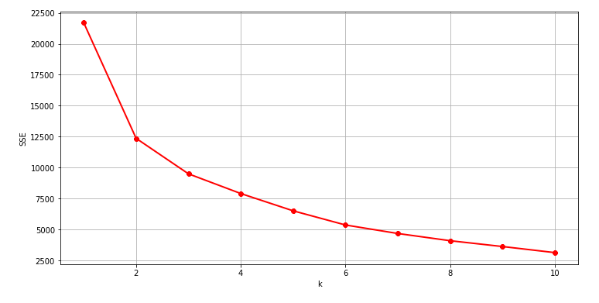
Data Clustering -Elbow Method

Slide 12
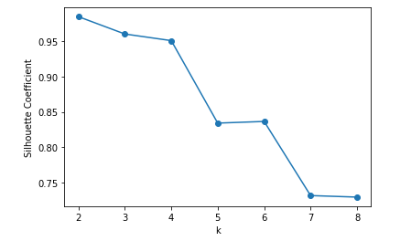
-Silhouette_Score Analysis

Slide 13
Thank You!
For more information:
Company Information: JR Academy https://jracademy.com.au/
Connect information: mingjinhelena@gmail.com

